Slide 1
Detecting Fake Accounts on Instagram
By
Vamsy Sivaarcca Pisipati
Venkata Ramakrishna Chelpuri

Slide 2
CONTENTS
Abstract
Problem statement and Business Case
Prerequisites and Technologies used
Output
Steps to run
Conclusion

Slide 3
ABSTRACT
Instagram is a photo and video sharing social networking service owned by American company Meta Platforms. The app allows users to upload media that can be edited with filters and organized by hashtags and geographical tagging. Posts can be shared publicly or with pre approved followers. However, there have been a huge number of reports by users regarding fake accounts on instagram. In this project, with the use of multiple machine learning techniques, to detect these fake accounts. We pre processed a dataset for this purpose. The algorithms were used to calculate the accuracy and error rate of classifiers by displaying the results of each classifier using bar graph.

Slide 4
Problem Statement and Business Case
There are a huge number of users of Instagram who upload photos, videos, reels, etc. There are 2 types of profiles, public and private. As the names suggest, anyone can view the public profiles while only approved number of followers can view a private profile. In the current world scenario, instagram has become a major platform for various businesses helping the Entrepreneurs.
Hence, it all comes down to a simple equation, “Higher the followers, Better the business”. This has resulted in the increase of the risk of fake instagram profiles.

Slide 5
Prerequisites or Technologies used
Uses Machine Learning algorithms to classify user accounts into real or fake.
Libraries used: pandas, numpy, tkinter, matplotlib, sklearn
Algorithms used: Naive Bayes, Linear SVC and K-Nearest Neighbour.

Slide 6
The model runs as follows:
Select Custom user account.
Select the dataset.
Sample Classifier Accuracy.
Classifier Comparison.

Slide 7
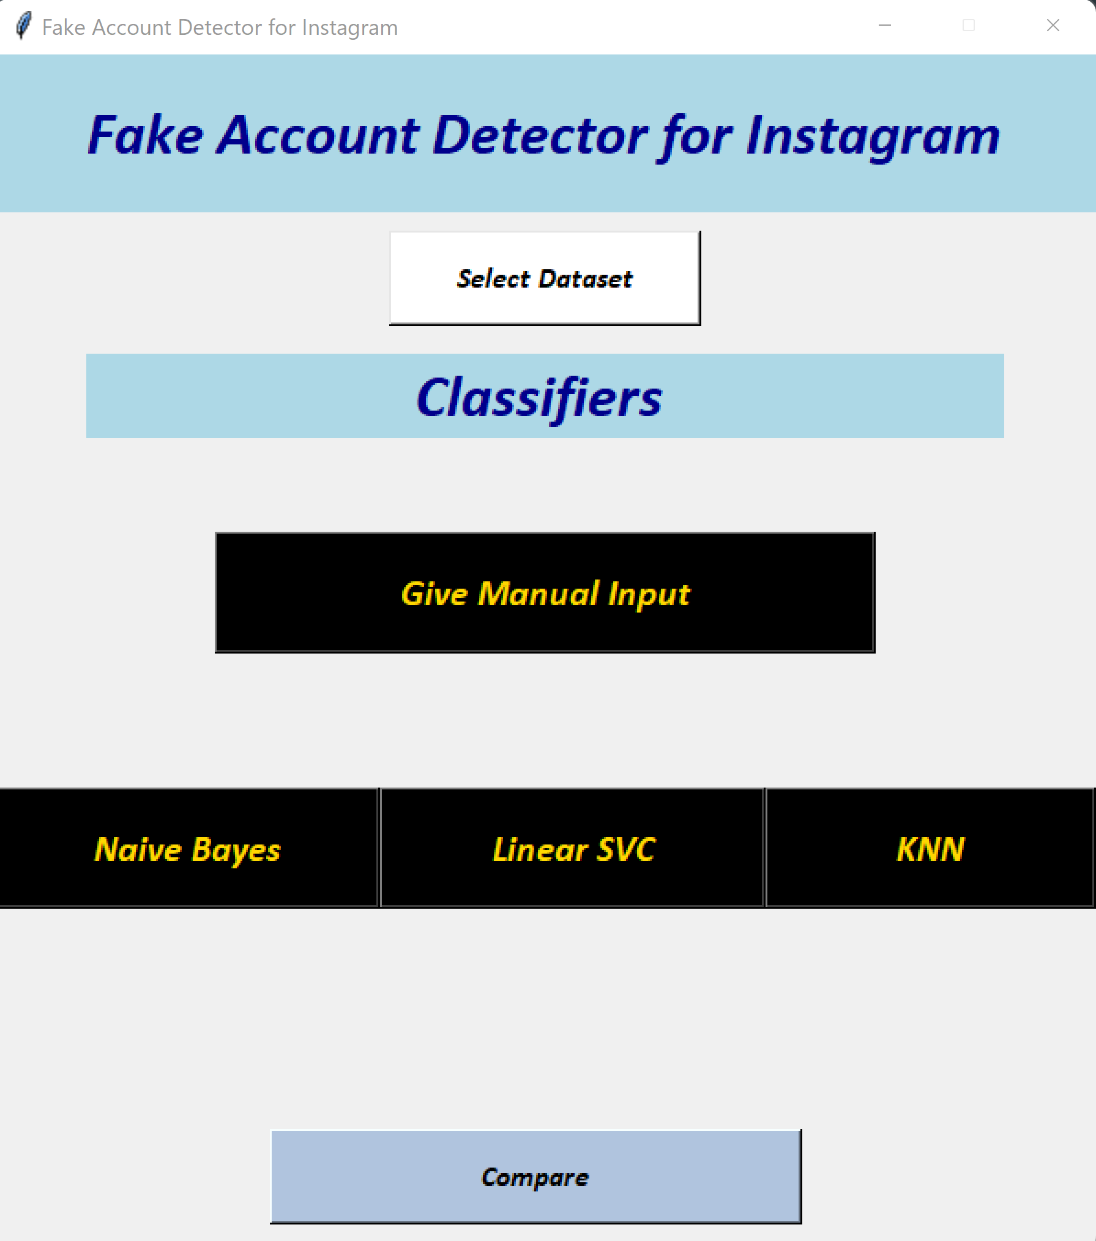
Output Window
User can browse a dataset from local system and select a classifier to display the prediction and its accuracy, error rate metrics.
User can either use ‘Give manual Input’ button to predict whether a particular account is fake or not.

Slide 8
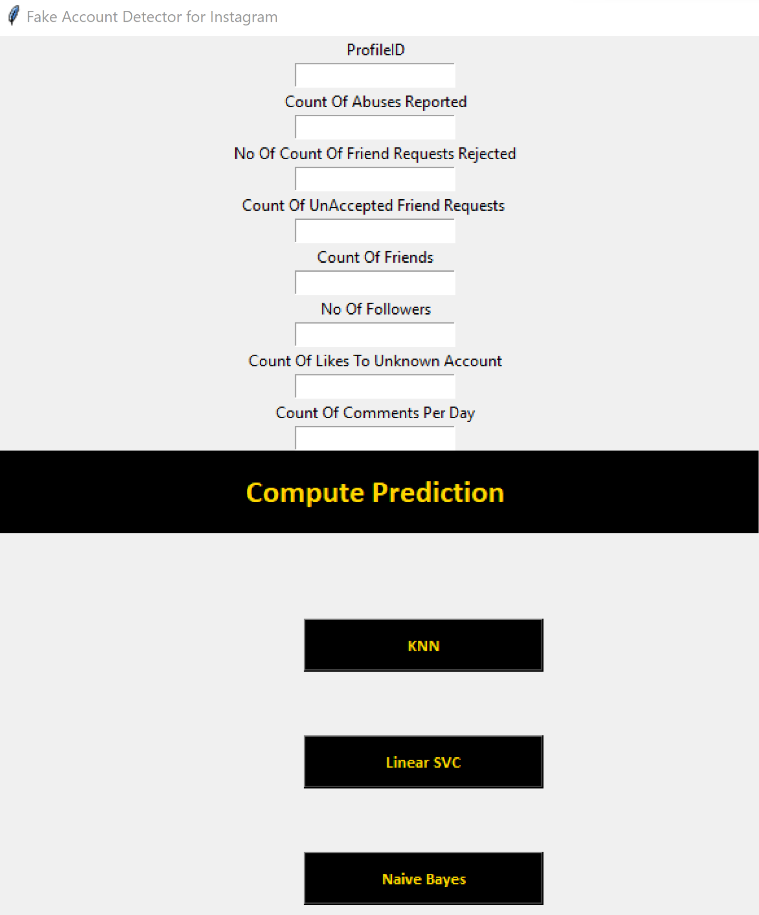
Manual Input
User can manually enter Account details then select a Classifier to predict whether the account is Fake or Not.

Slide 9
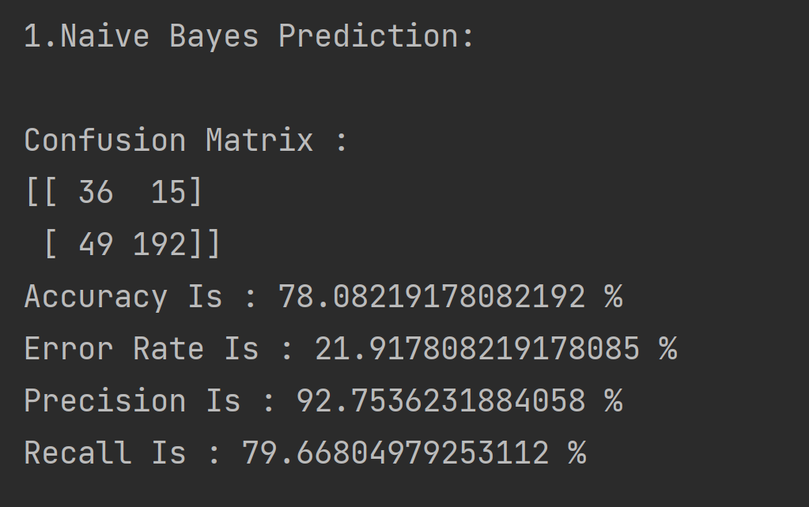
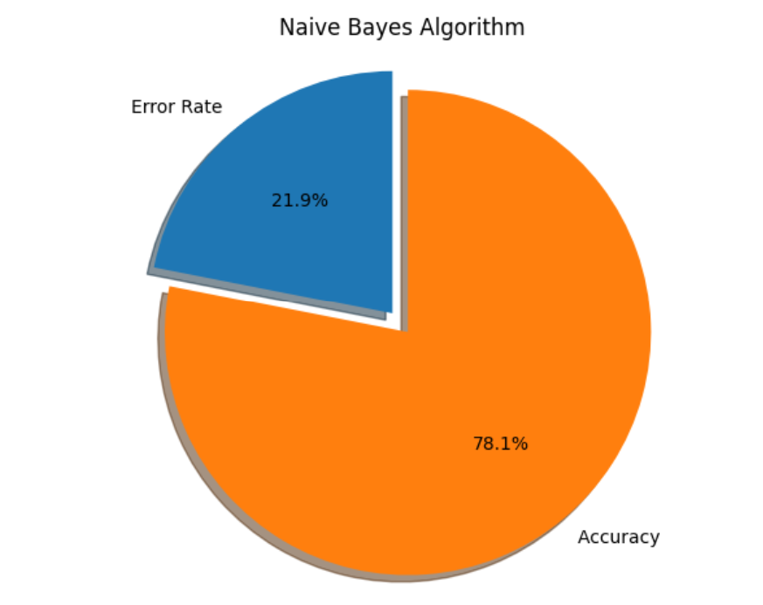
Naive Bayes Model Metrics

Slide 10
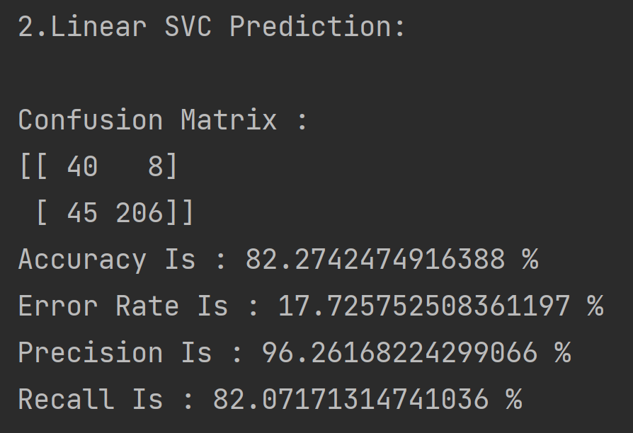
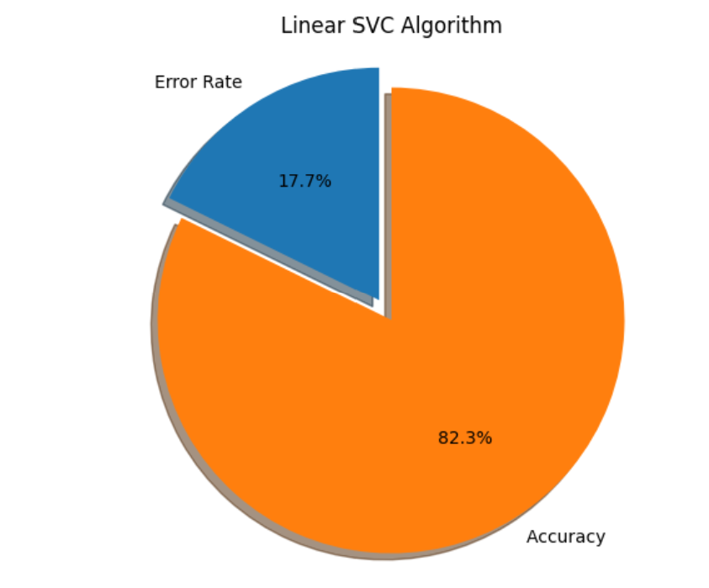
Linear SVC Model Metrics

Slide 11
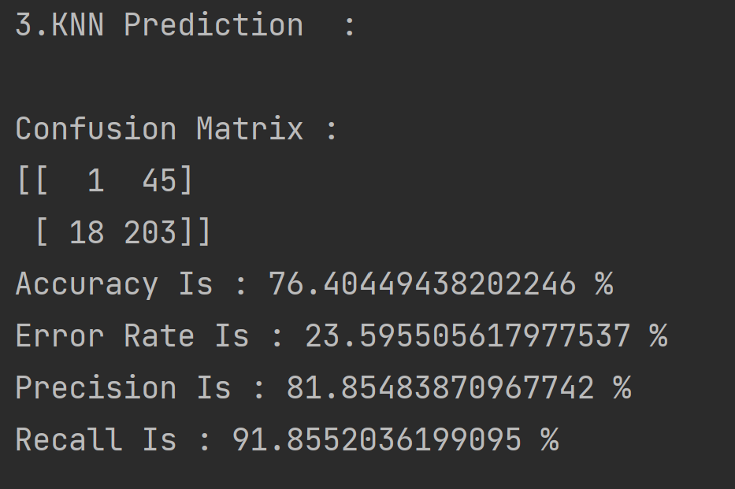
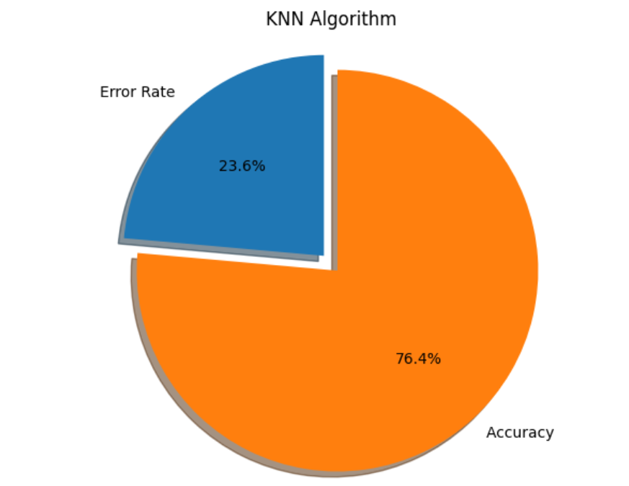
KNN Model Metrics

Slide 12
Steps to run on python
Install required libraries using:
pip install <library>
Execute the python code using:
python model.py

Slide 13
Conclusion
With this project, the goal of detecting fake user profiles on instagram has been achieved using Supervised learning Algorithm which is used to identify the effective feature set for fake accounts detection in instagram social network. On a larger scale, this is really helpful with the growing number of fake profiles and scams that happen through them. Machine Learning techniques help us overcome this issue.

Slide 14
Thank You

